Slide 1
Energy conversion
Power Plant : General layout of thermal power plant and heat to work/power
conversion, efficiency of conversion. Requirements of coal, air and water just
to produce unit of electricity

Slide 2
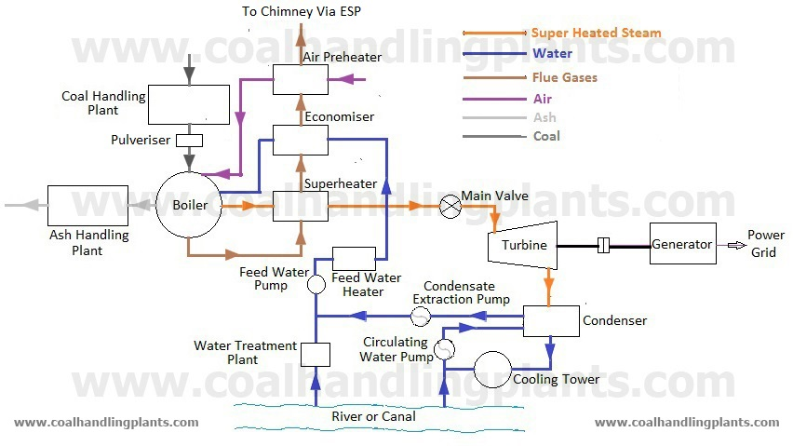

Slide 3
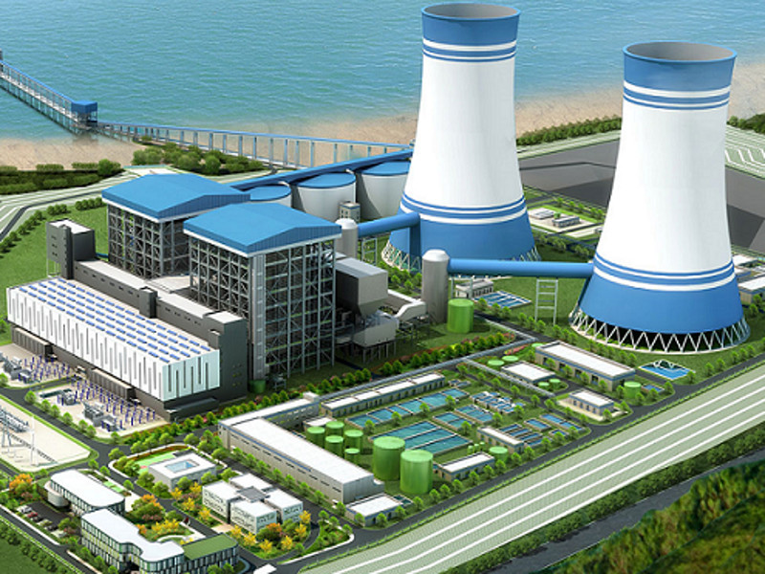
Thermal Power plant
Notes:
Thermal Power plant

Slide 4
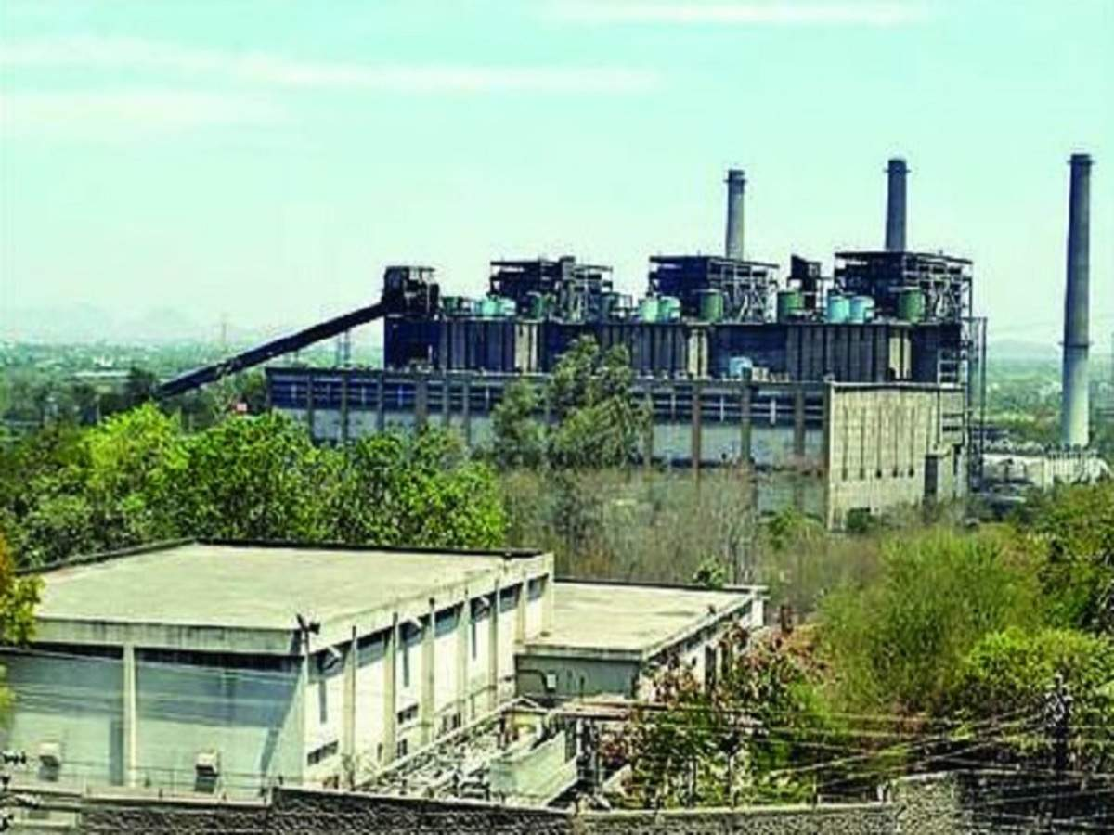

Slide 5
TPP Animation
https://www.youtube.com/watch?v=IdPTuwKEfmA

Slide 6
TPP
A thermal power station is a power station in which heat energy is converted to electricity. Typically, fuel is used to boil water in a large pressure vessel to produce high-pressure steam, which drives a steam turbine connected to an electrical generator.

Slide 7
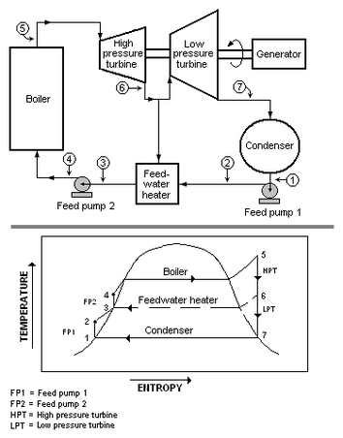

Slide 8
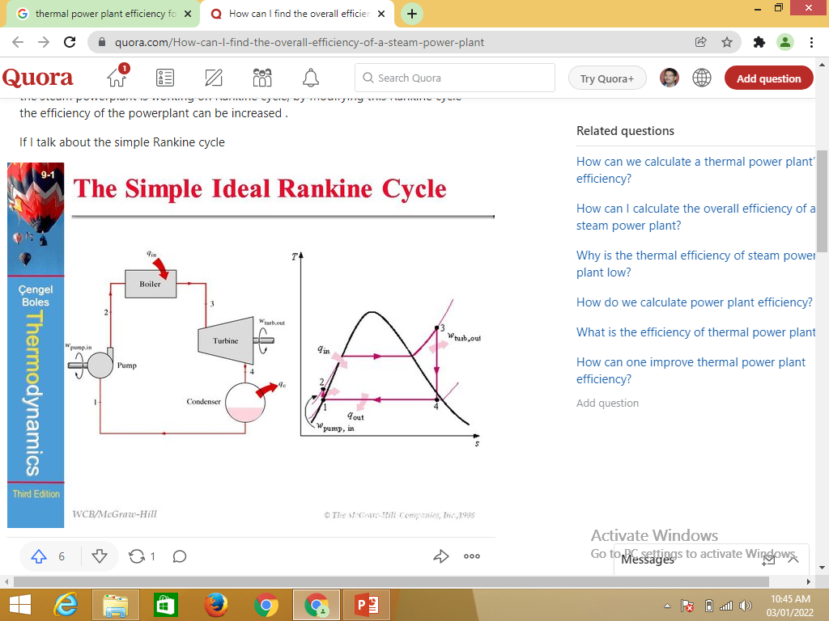

Slide 9
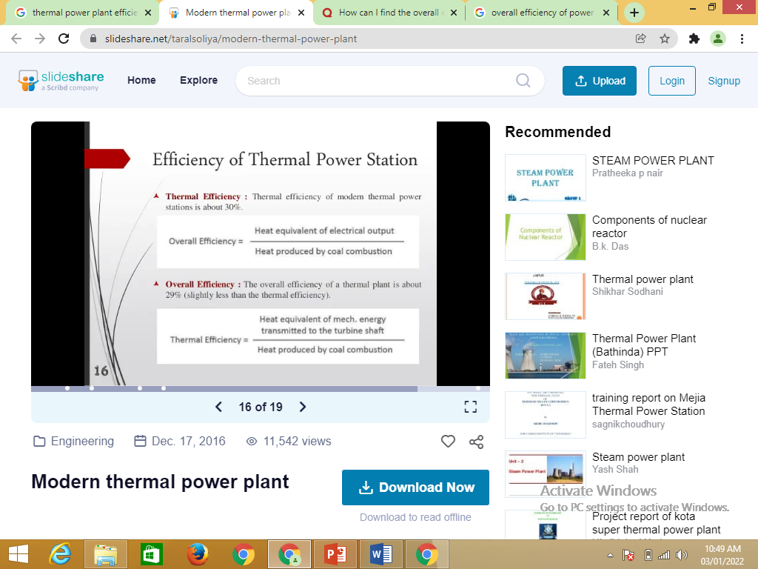

Slide 10
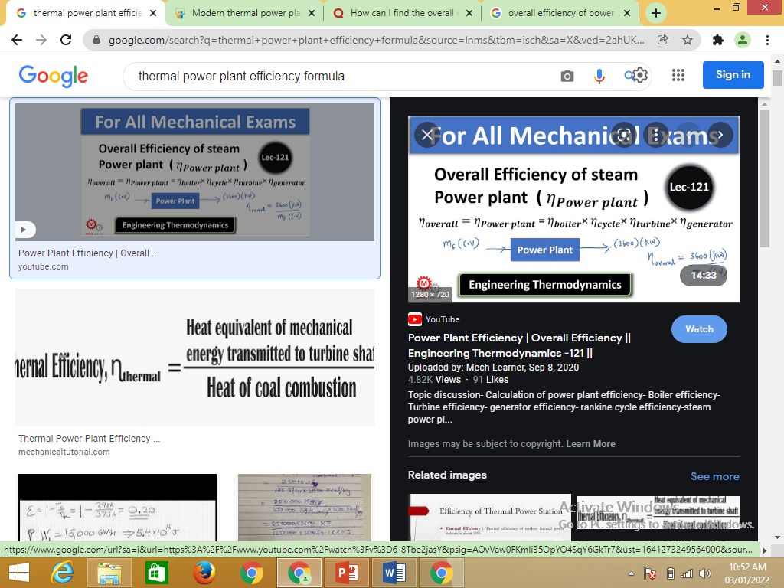

Slide 11
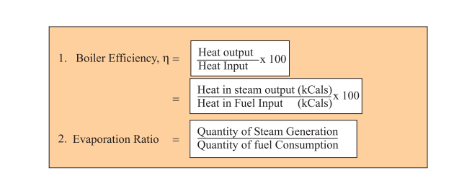

Slide 12
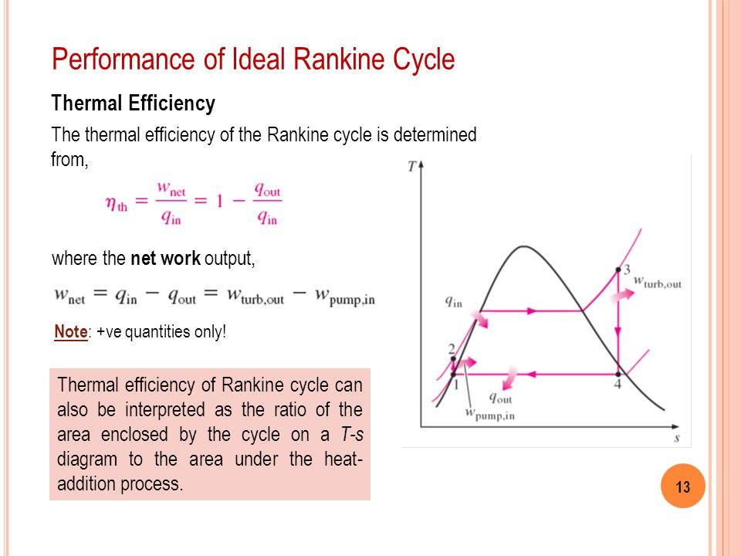

Slide 13
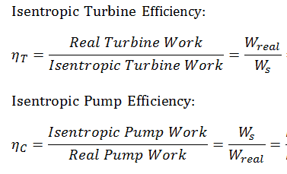

Slide 14
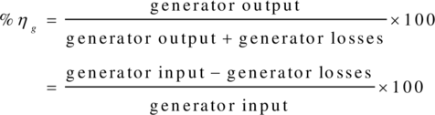

Slide 15
Requirements of coal, air and water just to produce unit of electricity

